Slide 1
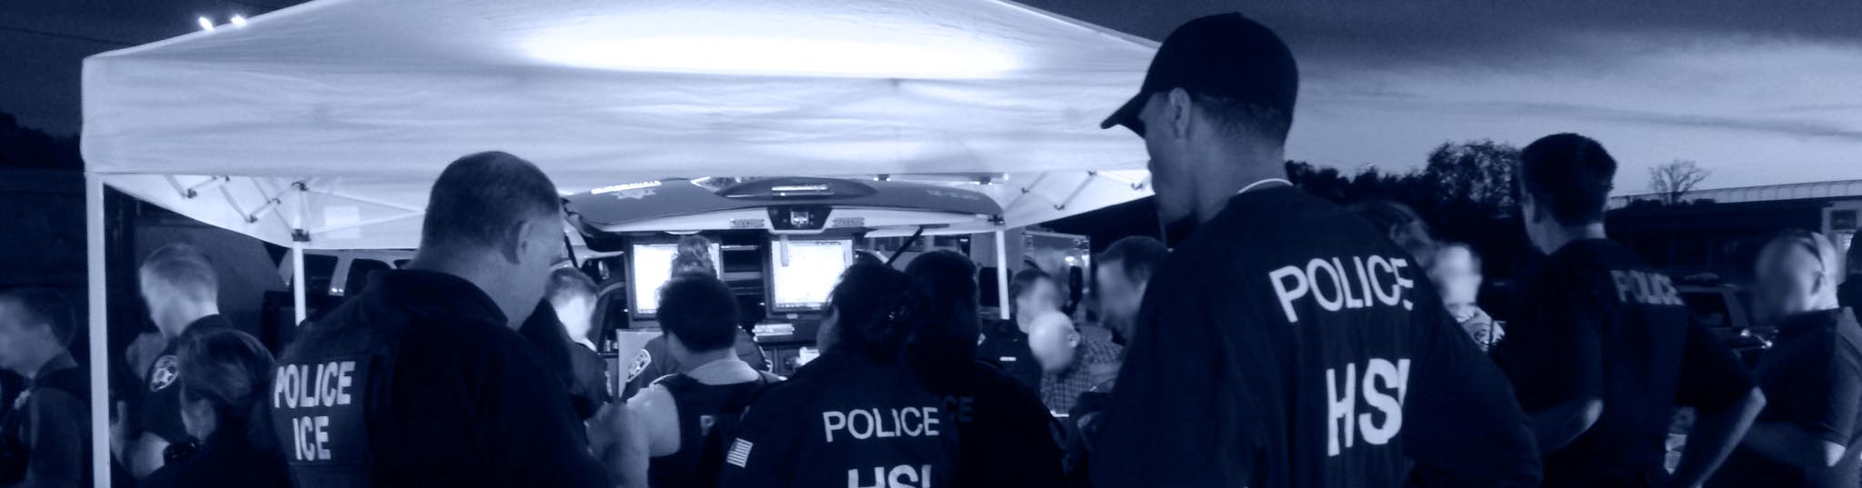


HALF PHOTO SLIDE PAGE TITLE
FOR QUOTES AND SUCH
HSI
Homeland Security Investigations

Slide 2
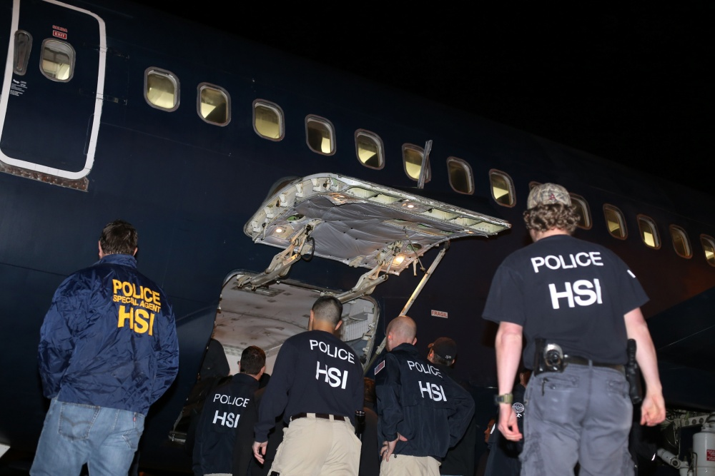

About HSI
The U.S. Immigration and Customs Enforcement (ICE) Homeland Security Investigations (HSI) directorate is a critical asset in the ICE mission, responsible for investigating a wide range of domestic and international activities arising from the illegal movement of people and goods into, within, and out of the United States.
HSI is the principal investigative arm of the U.S. Department of Homeland Security (DHS).
Vision Statement: To secure the Homeland from transnational criminal threats.
Mission Statement: To investigate, disrupt, and dismantle terrorist, transnational, and other criminal organizations that threaten or seek to exploit the customs and immigration laws of the United States.

Slide 3
Global Footprint
Canada
Europe
Asia
U.S.A.
Middle East
& Africa
Mexico
S. America &
Caribbean
Employees: 8,500 +
Special Agents: 6,000 +
Domestic Offices: 210
International Offices: 63
Australia

Slide 4
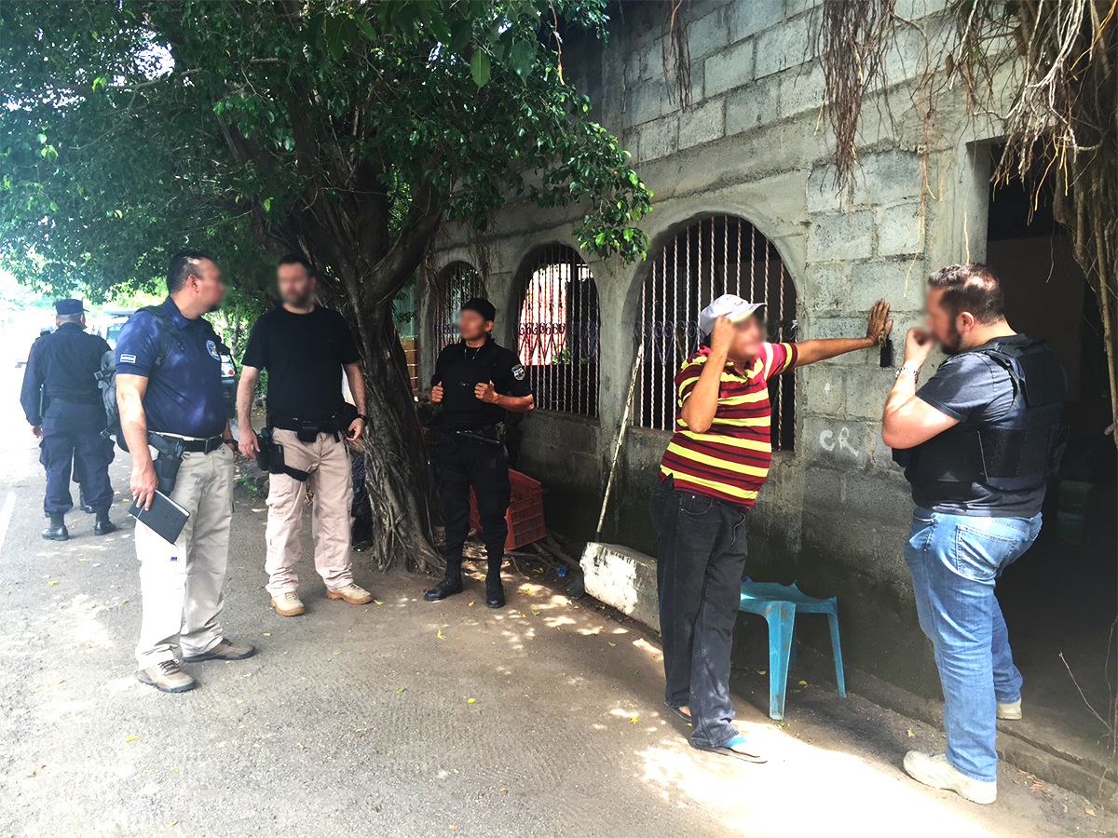
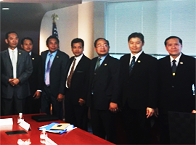
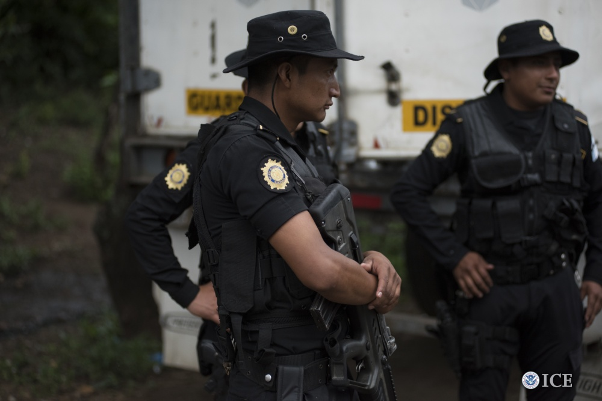
Global Footprint
HSI is DHS’ largest investigative law enforcement presence overseas. HSI advances U.S. based investigations by:
Coordinating with foreign counterparts;
    Disrupting transnational criminal organizations before they bring illicit products, people, and proceeds into or out of the United States; and
    Building international partnerships and increasing foreign capacity through outreach and training.

Slide 5
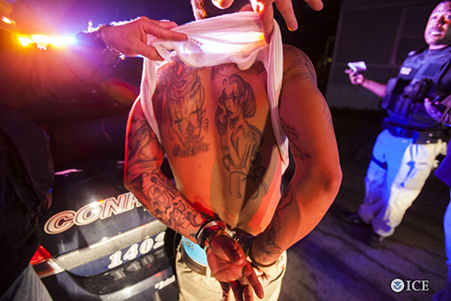

A Year in Protecting the Homeland
32,709
Criminal Arrests for FY 2016
Average
90 Each Day
=

Slide 6
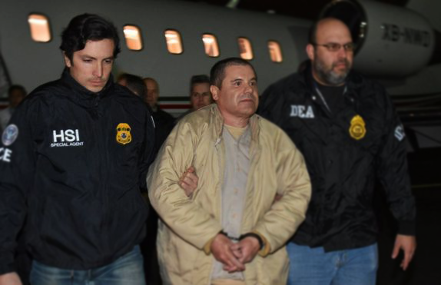
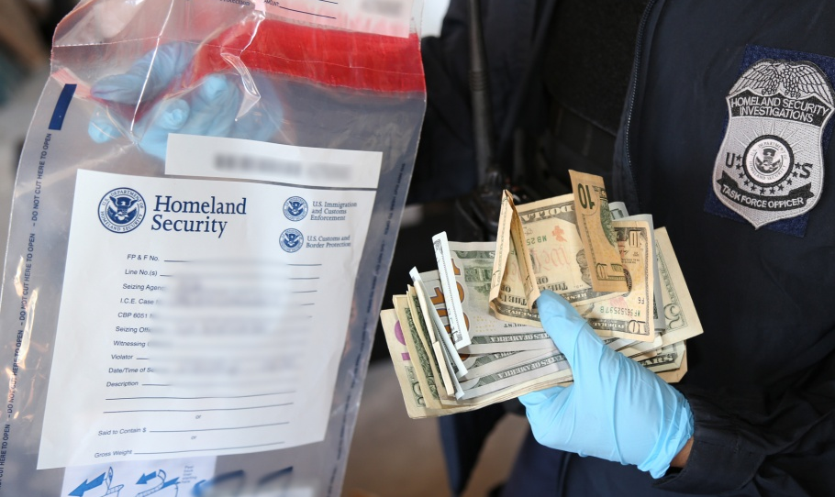
A Year in Protecting the Homeland
Indictments for FY 2016
20,221
Convictions for FY 2016
15,922

Slide 7









HSI Protects & Ensures
By targeting transnational threats, both at home and abroad, HSI protects and ensures:
Border Security
Homeland Security
Public Safety
Public Health
Global Trade
U.S. Economy
U.S. Technology
War Fighters
U.S.
Economy

Slide 8
HSI Investigates
  HSI enforces a diverse portfolio of federal laws,
  more than any other federal agency.

Slide 9












HSI Investigates
HSI is responsible for investigating violations of U.S. customs and immigration laws pertaining to border security, homeland security, and public safety—all of HSI’s mission sets have a nexus to these three areas.
Border Security
Homeland Investigations
Counter-
Proliferation
Child
Exploitation
IP and Trade
Enforcement
Identity and
Benefit Fraud
General
Smuggling
Public Safety
Homeland Security
Human
Trafficking
Human
Smuggling
Worksite
Enforcement
Narcotics
Enforcement
Transnational
Gangs
Financial
Crimes

Slide 10






Strategic Mission Priorities
Homeland Security/Counter-Terrorism: To protect the homeland from terrorists who seek to do harm to the U.S.
HSI’s unique combination of law enforcement authorities enables HSI to target the people, money, and materials that support terrorist activities and to identify and prevent systemic vulnerabilities in the nation’s border, financial, trade, and transportation systems.
HSI is the only federal agency with the full range of investigative and border-related authorities to investigate and enforce all U.S. export laws related to military items, sensitive dual-use commodities, and sanctioned or embargoed countries.
2,203
2.2 million
seizures for violations of various U.S. export laws and regulations in FY 2016
visa applications were screened in FY 2016, and
8,599
were refused based on terrorist connections or derogatory information
Impact:

Slide 11



Strategic Mission Priorities
Child Exploitation/Cybercrimes: To combat criminal activity conducted on or facilitated by the internet—transitioning from the physical to virtual world.
HSI has established itself as a world leader in online child exploitation investigations due to the wide range of its authorities and presence throughout the world.
HSI’s cyber related investigations focus on the transnational criminal organizations that use cyber capabilities to further their criminal enterprise.
820
6.3 petabytes
sexually exploited children identified and/or rescued in FY 2016
total data examined by HSI in FY 2016 - The equivalent of approximately:
81 years
of high definition video play
Impact:

Slide 12


Strategic Mission Priorities
Human Trafficking/Human Smuggling: To identify transnational criminal organizations engaged in human trafficking and human smuggling, and investigate the groups that pose the greatest risk to the U.S.
HSI is the leader in the global fight against human trafficking. HSI utilizes all of its authorities and resources in a cohesive global enforcement response in order to dismantle the global criminal infrastructure engaged in human trafficking.
HSI is the lead federal agency with the full range of investigative and border-related authorities to investigate human smuggling.
2,110
cases initiated for human smuggling in FY 2016
435
HSI’s worksite enforcement and identity and benefit fraud programs further support HSI’s efforts to prevent human trafficking and human smuggling.
victims of human trafficking identified in FY 2016
Impact:

Slide 13

Strategic Mission Priorities
Transnational Gangs/Narcotics: To enhance public safety through investigations of dangerous narcotics and transnational gangs.
HSI prioritizes transnational criminal organizations that exploit U.S. borders, DHS trusted traveler programs, DHS insider threats, and other border vulnerabilities such as tunnels.
HSI’s unique dual federal authorities, both criminal and administrative, have made HSI a leader in criminal investigations targeting transnational street gangs, prison gangs, and outlaw motorcycle gangs that pose a threat to the public safety and homeland security.
HSI’s narcotics enforcement investigations focus on border violators and the transnational criminal organizations they support.
1.5 million
pounds of narcotics seized in FY 2016
4,606
transnational gang members criminally arrested in FY 2016
Impact:

Slide 14







Strategic Mission Priorities
Every criminal case HSI investigates, regardless of category, has a financial nexus. HSI seeks to identify not only the illicit proceeds of crime but also target the financial networks and third-party facilitators hiding the illegal proceeds.
$473 Million
Illicit currency and assets seized in FY 2016
Homeland Security/ Counter-Terrorism
Child Exploitation/
Cybercrimes
Human Trafficking/
Human Smuggling
Transnational Gangs/
Narcotics

Slide 15

Q
A
&
Protecting the Homeland with Honor, Service, and Integrity

